Slide 1
Database System
Chapter0: Course Introduction
Database Systems

Slide 2
Objectives
To provide students with
  Basic Knowledge on database models
  Designing relational database
  Skill in using SQL statements and SQL Server

Slide 3
Course content
Introduction to Database Systems and Database Management Systems
Design theory of Relational Databases
Relational Database Programming

Slide 4
Microsoft SQL Server
Microsoft SQL Server is a relational database management system developed by Microsoft. As a database server, it is a software product with the primary function of storing and retrieving data as requested by other software applications—which may run either on the same computer or on another computer across a network (including the Internet) (wikipedia)
Edition used in this course:
  SQL Server Developer Edition (free for being used as development and test system, not as production server)

Slide 5
Setup steps
Run ISO file
In Installation tab of SQL Server Installation Center window:
  choose New SQL Server stand-alone installation or add features to an existing installation
In Product Key, choose Specify a free edition, and Developer then Next.
Check I accept the license terms then Next.

Slide 6
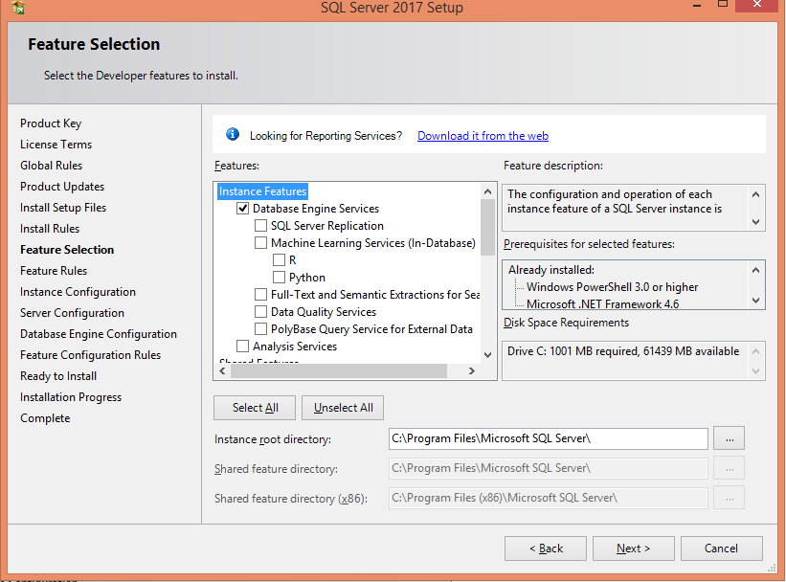
Select options and Set directory

Slide 7
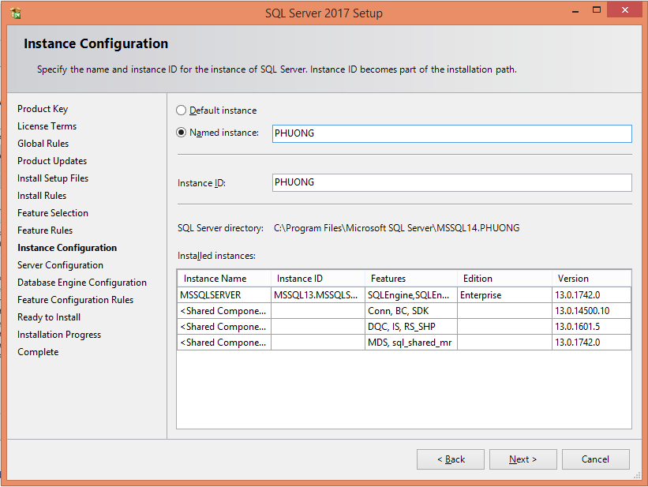
Select the default instance or provide a name for a named instance

Slide 8
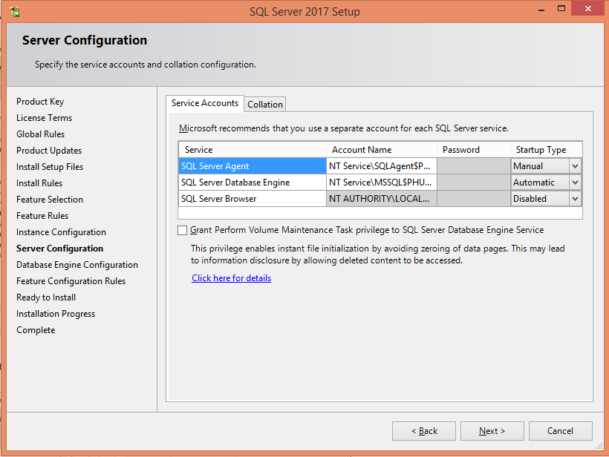
Review Server Configuration

Slide 9
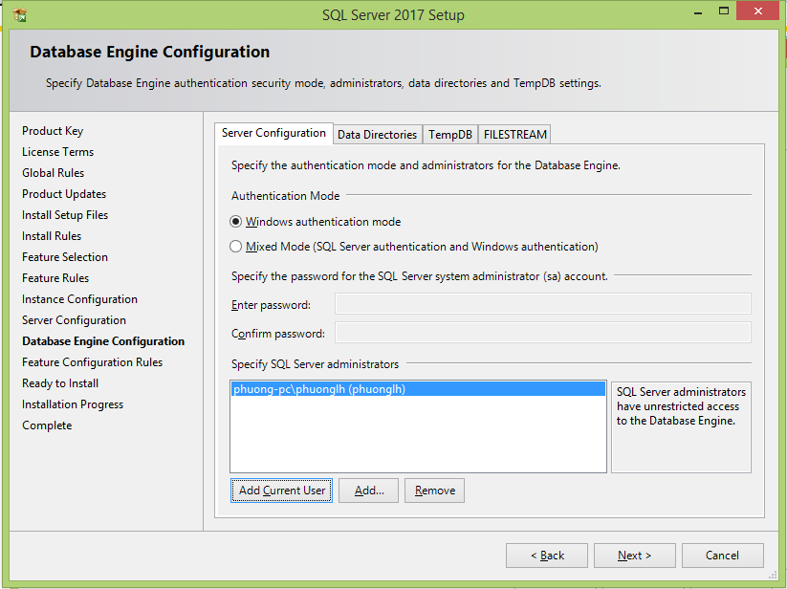
Configure Security

Slide 10
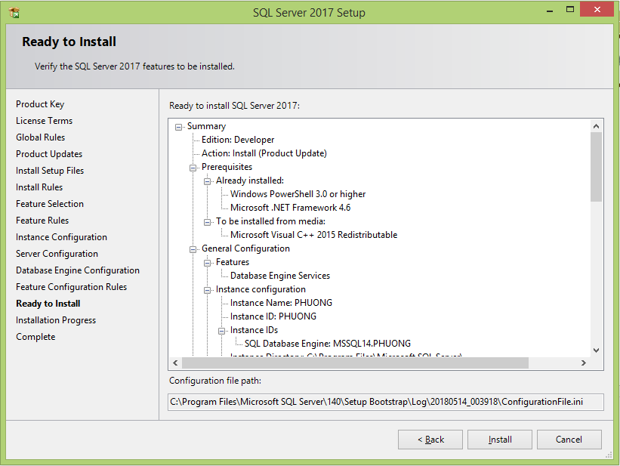
Install

